Slide 1
MIS End Sem Project
Algorithms for Exploration and Exploitation in Reinforcement Learning

Slide 2
Introduction:
Sometimes, we all suspect that changing the primary idea of our actions would yield the optimum output and would also make the end-users of the product feel more comfortable.
But we are often worried that a new action could potentially disorient users and make them feel less comfortable.
If that were true, our clever idea to increase sales might actually make the users buy fewer products instead.
Notes:
Arrun

Slide 3
Approaches:
Our approach is to believe that we can’t just decide to perform an action then assume that the action is responsible for whatever happens next. For this, we’ll need to run a controlled experiment. After all, there may be so many other parameters that may influence our experiment.
Two Possibilities:
A/B testing setup: Groups A and B of users would see slightly different versions of the event; One including the action while the other without it.
Experiment run until we become convinced that either Option A is more successful than Option B or, vice versa.
Maximize event rewards; run experiments that could be well rewarded.
Unless we really believe an action we do has the potential to be valuable, we shouldn’t try it at all. And if we don’t have any new ideas that we have faith in, going with the traditional action is the best strategy.
Notes:
Arrun

Slide 4
How to decide which action would be highly rewarded without trying them out?
Back to square one
Notes:
Arrun

Slide 5
Exploration Vs exploitation
We can decipher that there is always going to be a fundamental trade-off between the goals that motivate us to follow both the approaches to maximize our rewards.
We need a simple way to balance the need to:
Learn new things and
Profit from old things that we had already learned.
We call experimentation as exploration and we call profit maximization as exploitation.
Unfortunately, there is no simple answer for the question on what to prioritize. Like we suspected, there is no universal solution to balancing your two goals.
To learn which ideas are good or bad, we have to explore — at the risk of losing money and bringing in fewer profits/rewards.
To exploit a result means we lose a chance to learn and a possibility to have earned higher rewards.
The right way to choose between exploring new ideas and exploiting the best of our old ideas depends on the details of our event and situation.
Notes:
Arrun

Slide 6
Why situation dependant?
Answering this question properly requires that we return to the concepts of exploration and exploitation. Standard A/B testing consists of:
A short period of pure exploration, in which we assign equal numbers of users to Groups A and B
A long period of pure exploitation, in which we send all of our users to the more successful version of our event and never come back to the option that seemed to be inferior.
Why might this be a bad strategy?
It jumps discretely from exploration into exploitation, when we might be able to smoothly transition between the two.
During the purely exploratory phase, it wastes resources exploring inferior options in order to gather as much data as possible. But we shouldn’t want to gather data about strikingly inferior options.
Notes:
Arrun

Slide 7
Bandit Algorithms
Bandit algorithms provide solutions to both of these problems:
They smoothly decrease the amount of exploring they do over time instead of requiring us to make a sudden jump and
They focus our resources during exploration on the better options instead of wasting time on the inferior options that are over explored during typical A/B testing.
In fact, bandit algorithms address both of those concerns in the same way because they gradually fixate on the best available options over time.
In the academic literature, this process of settling down on the best available option is called convergence. All good bandit algorithms will eventually converge.
Notes:
Arrun

Slide 8
Solving the problem
Using four main algorithms
Notes:
Arrun

Slide 9
Epsilon Greedy Algorithm
Based on random selections
Notes:
Prashanth

Slide 10
Epsilon Greedy
A greedy algorithm is an algorithm that always takes whatever action seems best at the present moment, even when that decision might lead to bad long term consequences.
The Epsilon-Greedy algorithm is almost a greedy algorithm because it generally exploits the best available option, but every once in a while the Epsilon-Greedy algorithm explores the other available options.
The term epsilon in the algorithm’s name refers to the odds that the algorithm explores instead of exploiting.
Notes:
Prashanth

Slide 11
How it works?
Randomly oscillating between our first approach of purely randomized experimentation and our second approach in which we try to maximize our rewards.
It tries to be fair to the two opposite goals of exploration and exploitation.
Steps of working:
When a new user arrives, the algorithm flips a coin that comes up tails with probability Epsilon.
If the coin comes up heads, the algorithm is going to exploit. The more success rate, the more it will show it.
If the coin comes up tails, the algorithm is going to explore. It will pick any event with same probability
Notes:
Prashanth

Slide 12
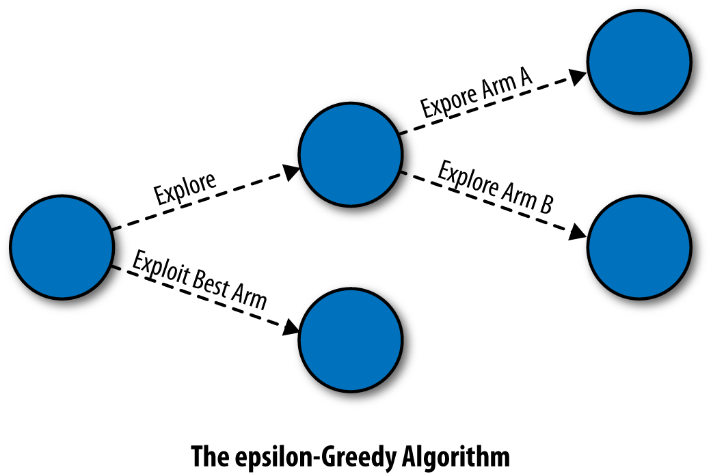
Pictorial representation
By definition of the algorithm that for an N-armed Bandit problem:
With probability 1 – epsilon, the epsilon-Greedy algorithm exploits the best known option.
With probability epsilon / N, the epsilon-Greedy algorithm explores the best known option.
With probability epsilon / N, the epsilon-Greedy algorithm explores the worst known option.
Notes:
Prashanth

Slide 13
Abstracting problem as bandit:
In general, we’re going to assume that we have a fixed set of N different options and that we can enumerate them, so that Option N is analogous to n^{th} Action.
Next, we need to define a reward. Mathematically, a reward is a quantitative measure of success implying that larger rewards are better than smaller ones.
We’re facing a complicated slot machine, called a Bandit, that has a set of N arms that we can pull on.
When pulled, any given arm will output a reward with any specific pull of any specific arm is risky.
We also don’t start off knowing what the reward rates are for any of the arms. We have to figure this out experimentally by actually pulling on the unknown arms.
Notes:
Prashanth

Slide 14
Need for abstraction
What makes a bandit problem special is that we only receive a small amount of the information about the rewards from each arm.
We only find out about the reward that was given out by the arm we actually pulled.
Whichever arm we pull, we miss out on information about the other arms that we didn’t pull. Just like in real life, you only learn about the path you took and not the paths you could have taken.
Not only do we get only partial feedback about the wisdom of our past decisions, we’re literally falling behind every time we don’t make a good decision.
Thus we need to choose arms in a sequence that will:
Learn about new arms and
Earn as much reward as possible by pulling on arms we already know are good choices.
Notes:
Prashanth

Slide 15
Implementing epsilon greedy algorithm
Using the concepts of abstraction
Notes:
Prashanth

Slide 16
Demerits of Epsilon Greedy
It explores options completely at random without any concern about their merits.
If the difference in reward rates between two arms is small, we’ll need to explore a lot more often than 10% of the time to correctly determine which of the two options is actually better.
In contrast, if the difference is large, we need to explore a lot less than 10% of the time to correctly estimate the better of the two options. For that reason, we’ll end up losing a lot of reward by exploring an unambiguously inferior option in this case.
If the difference between two arms is large enough, we end up wasting time on inferior options simply because the epsilon-Greedy algorithm always explores completely at random.
It seems clear that there’s a qualitative property missing from the epsilon-Greedy algorithm. We need to make our bandit algorithm care about the known differences between the estimated values of the arms
Notes:
Prashanth

Slide 17
SoftMax Algorithm
Based on slight modifications to existing Softmax
Notes:
Arrun

Slide 18
SoftMax Algorithm
The SoftMax algorithm tries to cope with arms differing in estimated value by explicitly incorporating information about the reward rates of the available arms into its method for choosing which arm to select when it explores.
We choose each arm in proportion to its estimated value.
If we have two arms A and B giving rewards rA and rB respectively. First, we will calculate a different scale for reward rates by exponentiating our estimates of rA and rB. Using this new scale, we will choose Arm A with probability exp(rA) /(exp(rA) + exp(rB)) and Arm B with probability exp(rB) / (exp(rA) + exp(rB)).
An additional parameter is a different sort of scaling factor than the exponentiation we just introduced.
Notes:
Arrun

Slide 19
Role of temperature
New parameter is a scaling factor called temperature denoted as tau.
We introduce tau to produce the following new algorithm:
At time T, select one of the two arms with probabilities computed as follows:
exp(rA / tau) / (exp(rA / tau) + exp(rB / tau))
exp(rB / tau) / (exp(rA / tau) + exp(rB / tau))
For whichever arm we picked, update our estimate of the mean using the same update rule we used for the epsilon-Greedy algorithm.
It’s easiest to think of tau as letting us shift the behaviour of the Softmax algorithm along a continuum defined by two extreme ways to select arms. At one extreme, we set tau = inf. This will give us a fully deterministic choice of the arm that has the highest estimated value. At the other extreme, we set tau = Inf, which gives us purely random exploration like we got out of the epsilon-Greedy algorithm.
Notes:
Arrun

Slide 20
Implementing SoftMax algorithm
Using the above discussed reforms to SoftMax activation function
Notes:
Arrun

Slide 21
Annealing SoftMax Algorithm
Based on random selections following a probability distribution
Notes:
Arrun

Slide 22
Annealing Softmax
On testing the Epsilon-Greedy Algorithm, it’s often a good idea to encourage an algorithm to explore less over time. In the Softmax algorithm, we can achieve that by slowly decreasing the temperature, which we call annealing.
This will make our algorithm exploit the best arm more often and settle into its final deterministic strategy for choosing an arm.
In that case, we set temperature in a logarithmic scale e.g 1/math.log(1.0000001), which is very close to being infinite. So the temperature is extremely high and the system will explore almost completely randomly.
But, as t goes up, the temperature will get lower and lower. Because we use logarithms, this decrease isn’t extremely rapid: rather, it’s just rapid enough to be effective.
This division by a logarithmically scaled version of t isn’t always the best approach to annealing. In the code, we’ll do a linear decrease of temperature for convenience.
Notes:
Arrun

Slide 23
Implementing Annealing SoftMax
Using the decrease in temperature that we have to code
Notes:
Arrun

Slide 24
Upper confidence bound Algorithm
Based on a systematic exploration and progress tracking of each arm
Notes:
Prashanth

Slide 25
Upper confidence bound
The three algorithms we’ve presented so far have one systematic weakness: they don’t keep track of how much they know about any of the arms available to them.
This means that they’ll under‐explore options whose initial experiences were not rewarding.
We can do better by using an algorithm that pays attention to not only what it knows, but also how much it knows. The algorithm, UCB, that we’ll present in this report does exactly this.
If we see Epsilon greedy and Softmax,
The algorithm’s default choice is to select the arm that currently has the highest estimated value.
The algorithm sometimes decides to explore and chooses an option that isn’t the one that currently seems best:
The UCB can make decisions to explore that are driven by our confidence in the estimated value of the arms we’ve selected.
The reason has to do with the nature of the rewards we receive from the arms: they’re noisy. We’d eventually realize that one arm which is inferior now may be actually better in the long run.
Notes:
Prashanth

Slide 26
Working Principle of UCB
UCB does not use randomness at all. Instead, UCB avoids being gullible by requiring us to keep track of our confidence in our assessments of the estimated values of all of the arms.
UCB doesn’t have any free parameters that you need to configure before you can deploy it.
It just ensures that it has played every single arm available to it at least once.
It insures that the UCB algorithm knows a little bit about all available options, which makes it very effective when there are clearly inferior arms that can be essentially ignored right from start. Once we’ve gotten past the initial cycling through all of the available arms.
The ucb_value combines the simple estimated value of each arm with a special bonus quantity, which is math.sqrt((2 * math.log(total_counts)) / float(self.counts[arm])). The most basic statement that can be made about it is that it augments the estimated value of any arm with a measure of how much less we know about that arm than we know about the other arms.
Notes:
Prashanth

Slide 27
Disadvantages of UCB
Since this algorithm tries every arm or every possible action, we must ensure actions do no exhaust total tries.
The bonus quantity becomes a big boost in the effective value of the arm for arms that we know little about.
We try hard to learn about arms if we don’t know enough about them, even if they seem a little worse than the best arm. In fact, this curiosity bonus means we’ll even occasionally visit the worst of the arms we have available. This curiosity bonus means that UCB can behave in very surprising ways.
Because of back pedalling and experimenting with inferior arms, we can naturally come to the conclusion that it knows too little about those arms.
This back pedalling matters less and less over time, but it’s always present in UCB’s behaviour, which means that UCB doesn’t become a strictly greedy algorithm even if you have a huge amount of data.
Notes:
Prashanth

Slide 28
Implementing UCB
Using the systematic bonus calculations of each arm
Notes:
Prashanth

Slide 29
Comparing Algorithms
Key differences between them

Slide 30
Comparison of Algorithms
We see that the epsilon-Greedy algorithm doesn’t converge as quickly as the Softmax algorithm. This might suggest that we need to use another annealing or conclude that Softmax algorithm is simply superior to the epsilon-Greedy algorithm.
UCB is quite systematic and converges in the same time as Annealing Softmax, but the backpedaling it does causes it to underperform the Softmax algorithm along most metrics.
Thus we conclude saying that Annealing softmax on a logarithmic scale is a very good algorithm to get an output for short runs, but UCB is the best if we ignore backpedalling for long runs.
Notes:
Arrun

Slide 31
What? When? why?
We saw several Bandit Algorithms. But we did not explore use cases.
It’s important to understand that A/B testing and MAB serve different use cases as their focus is different.
In conclusion, it is fair to state that both A/B and MAB have their strengths and shortcomings- the dynamic between the two is complementary and not competitive.
A-B Testing | Multi Armed Bandit
Done to collect data with its associated statistical confidence. A business then uses the collected data, interprets it in a larger context and then makes a decision. | MAB is an optimization algorithm that maximizes a given metric. There’s no intermediate stage of interpretation and analysis as the MAB algorithm is adjusting traffic automatically.
The primary objective is to collect data in order to make a critical business decision and to learn the impact of all variations with statistical confidence. | There is no need for interpretation for results/performance of variations and all we care about is maximizing conversions. There’s not enough time for gathering statistical significant results.
Notes:
Arrun

Slide 32
Applications of a/b testing:
Situations where A/B testing is clearly superior to MAB :
Aiming for statistical significance: MAB experiments are not the best choice when you want to get a statistically robust winner. A/B tests are still the fastest way to statistical significance even though you might lose some conversions in the process.
Optimizing for multiple metrics: MAB experiments work great when optimizing for one key metric, they don’t work well for multiple goals as they only factor in the Primary Goal while allocating incoming traffic.
Post experiment analysis: Due to high Data availability for each run
Incorporating learnings from all variations
Notes:
Prashanth

Slide 33
Application of Multi Armed Bandit
Areas where MAB is clearly superior to A/B testing:
Opportunity cost of lost conversions is too high. When an event matters a lot due to it’s rewards
Optimizing Rates for Outlets That Cover Time-Sensitive Events: The short shelf life of news pieces means that quick optimization is essential.
Continuous Optimisation: Regression related problems
Optimizing Revenue with Low Traffic: Times when A/B testing will take lot of time to decipher statistical significance
Notes:
Prashanth

Slide 34
Thank you
Presentation by:
Arrun Sivasubramanian (CB.EN.U4AIE19013)
Prashanth VR (CB.EN.U4AIE19047)

